Slide 3
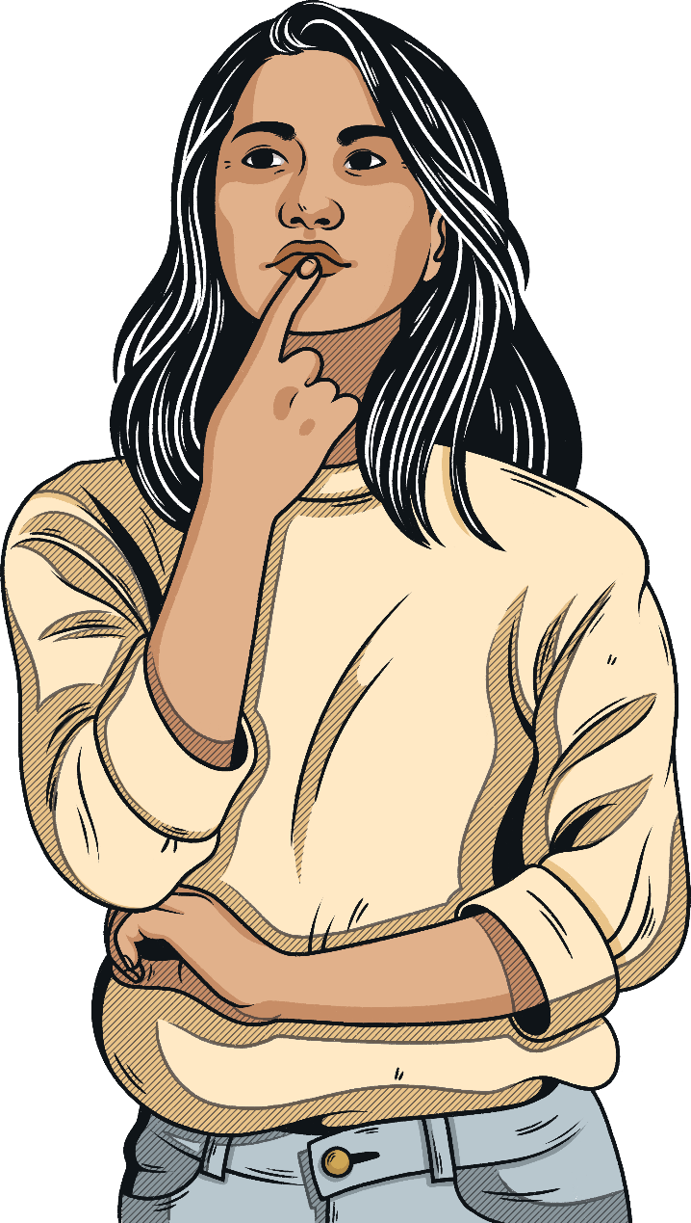
What Is Neurodiversity?
Everyone’s brain is different and unique.
Neurodiversity describes the differences in the way people’s brains work.
Everyone has their own way of thinking and interacting with the world around them.

Slide 4
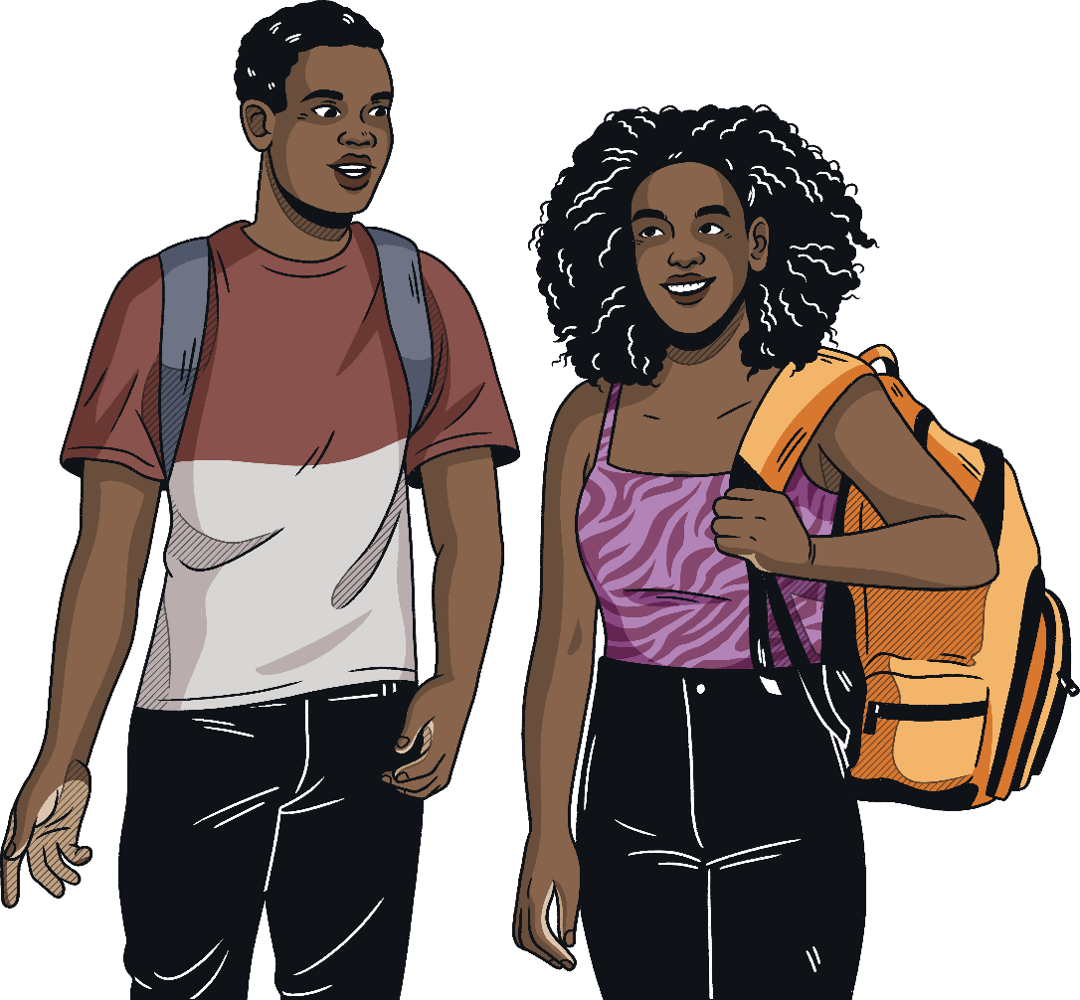
What Is Neurodiversity?
There are a number of neurological conditions that come under the umbrella term of ‘neurodiverse’ - you may have heard of the following ones:
Autism
Dyslexia
Dyspraxia
Attention Deficit Hyperactivity Disorder
Dyscalculia
Dysgraphia

Slide 5

What is Autism?
Every Autistic person is different.
Autism is a processing difference which people experience differences in three key areas:
social understanding and communication;
sensory processing and integration;
flexible thinking, information processing and understanding.
Language
Motor Skills
Sensory
Perception
Executive Function
Kirkleeslocaloffer.org.uk. (2023). Communication & Interaction (CCI or SLCN) | The 4 Areas of Need | Kirklees SEND Local Offer. [online] Available at: https://www.kirkleeslocaloffer.org.uk/sendco-professional-information-and-resources-page/the-4-areas-of-need/communication-interaction-cci-or-slcn/.

Slide 6

Autism – How Can I Help?
It is important to remember everyone likes and dislikes different things and to respect everyone's individual differences.
Talk to your friends and ask them how you can support - some individuals may need a quiet space, someone to talk to and share their thoughts or even someone to take a sensory break with.

Slide 7

Famous Autistic People
Christine McGuiness started her career as a model and is now a TV star and author.
Christine McGuinness
Christine recently found out she was Autistic, she also has three Autistic children.
In March 2023, Christine said, 'Autism is simply a different way of thinking and seeing the world, a different way of hearing, listening, communicating and socialising. My brain is different from others. But knowing what brain you’ve got helps you navigate differently.'

Slide 8
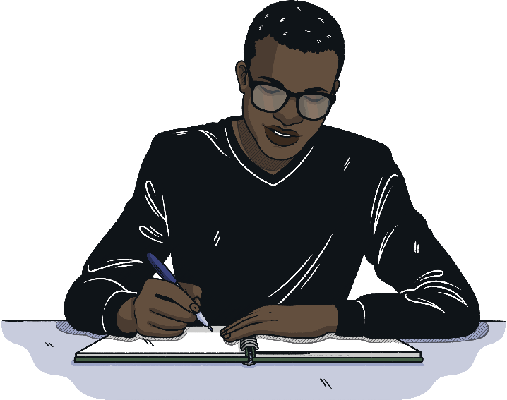
What is Dyslexia?
Dyslexia is a learning difference that may affect reading and writing skills and processing information.
Some dyslexic people might have particular strengths in other areas, such as design, problem-solving, creative skills, interactive skills and oral skills.

Slide 9
Dyslexia – How Can I Help?
Be patient and understanding with friends who have dyslexia. You may need to give them extra thinking time to answer your questions or to give their ideas when working in a group.
Be supportive to friends with dyslexia when marking or checking their work - they may find spelling difficult.
Ensure marking and feedback is positive.
Be helpful in class. Friends with dyslexia may need support to organise themselves in practical lessons, such as art and technology or other subjects where equipment and lots of resources may be required.
Support with reading aloud or checking new words can be helpful. Rehearsing reading together can also be useful.

Slide 10
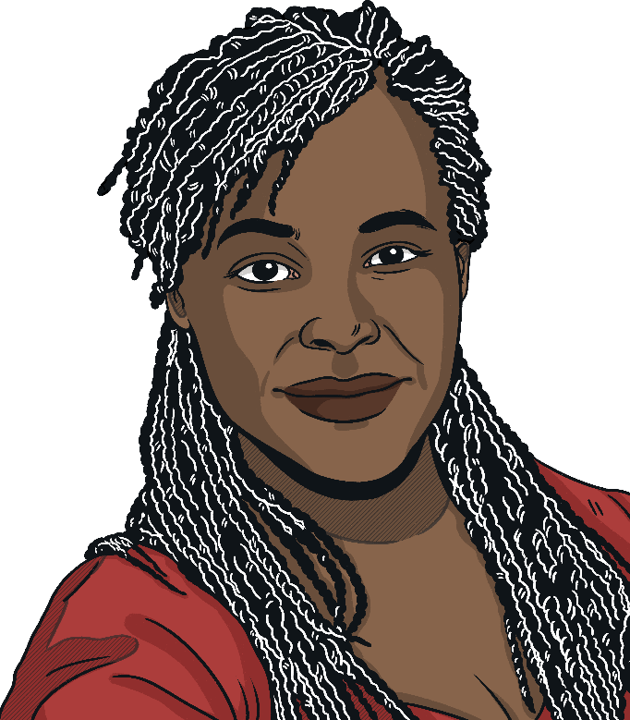
Famous Dyslexic People
Dr Maggie Aderin-Pocock
(scientist)
Maggie is a celebrated space scientist, mechanical engineer and science communicator.
She was diagnosed with dyslexia when she was eight years old and went to thirteen different schools.
Maggie graduated with a BSc in physics from Imperial College London and then went on to complete a PhD in mechanical engineering.
She has also spent time working for the Ministry of Defence (MoD). Here, she was involved in a variety of projects, from missile warning systems to landmine detectors.
After working for the MoD, Maggie returned to a job she loved; building instruments to explore the wonders of space.
Maggie is a co-presenter on the TV programme, The Sky at Night and is also involved in visiting schools where she can give children a ‘tour’ of the universe.

Slide 11
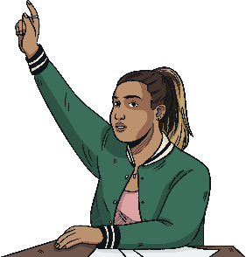
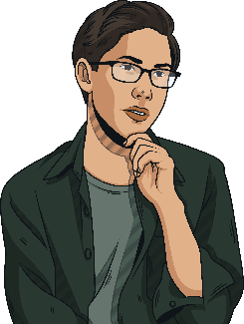
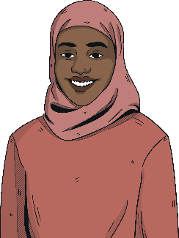
What Is Developmental Coordination Disorder (DCD), Also Known as Dyspraxia?
Dyspraxia, also known as developmental coordination disorder (DCD), …[affects] movement and coordination in children and adults. Each person experiences dyspraxia differently and how it affects an individual varies according to their age, life experience, environmental demands and the support given. (Dyspraxia Foundation, 2019)
Dyspraxia can affect the development of fine and gross motor skills, coordination, hand-eye coordination, speech and organisational skills.
Learners may require support with self-care including dressing, using cutlery and organising their personal belongings.
Learners may also require support to engage in gross motor activities, such as riding a bike and with fine motor skills such as cutting or using small tools.
People with dyspraxia often display a range of creative strengths and aptitudes.

Slide 12
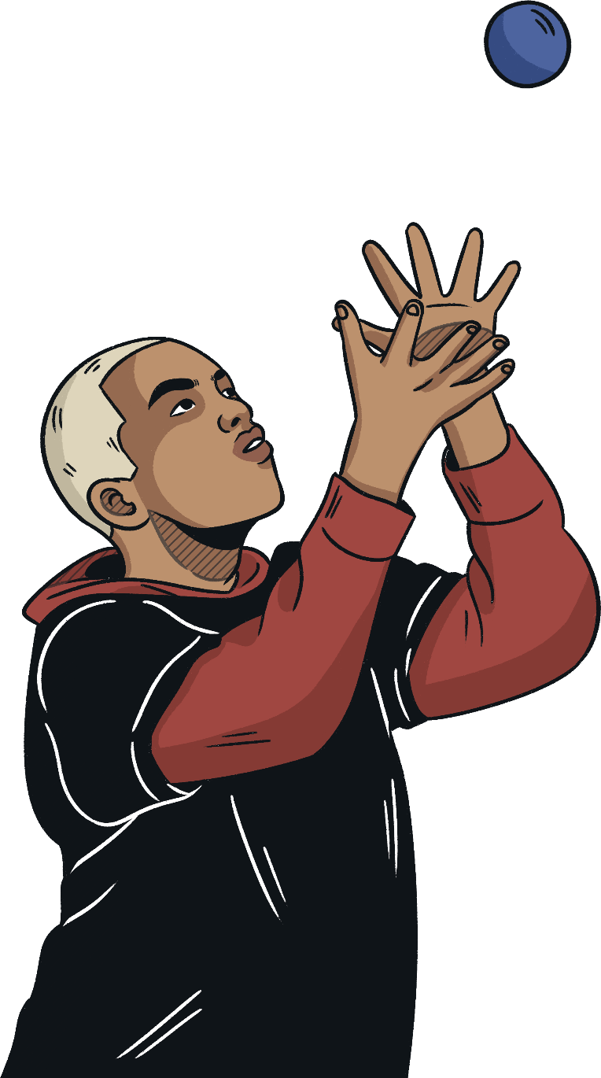
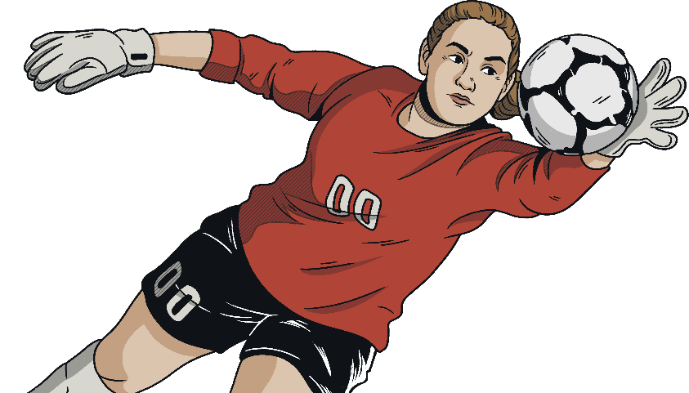
Dyspraxia – How Can I Help?
Be patient and understanding with friends who have dyspraxia. You may need to repeat instructions for them or give them extra thinking time to answer your questions.
Help them to organise their things or to remember all their belongings.
Be supportive in practical lessons such as PE, DT and Art.

Slide 13

Famous People with Dyspraxia
Daniel Radcliffe
(actor)
Daniel is an actor, mostly known for his role as Harry Potter.
In 2008, he revealed that he has a mild form of dyspraxia.
Daniel always dreamt of being an actor and after becoming a successful child actor, he went on to have numerous other roles, both in films and TV shows as well as on stage.
As an actor, he has won more than ten awards.
'It has never held me back, and some of the smartest people I know are people who have learning disabilities. The fact that some things are more of a struggle will only make you more determined, harder working and more imaginative in the solutions you find to problems.'

Slide 14
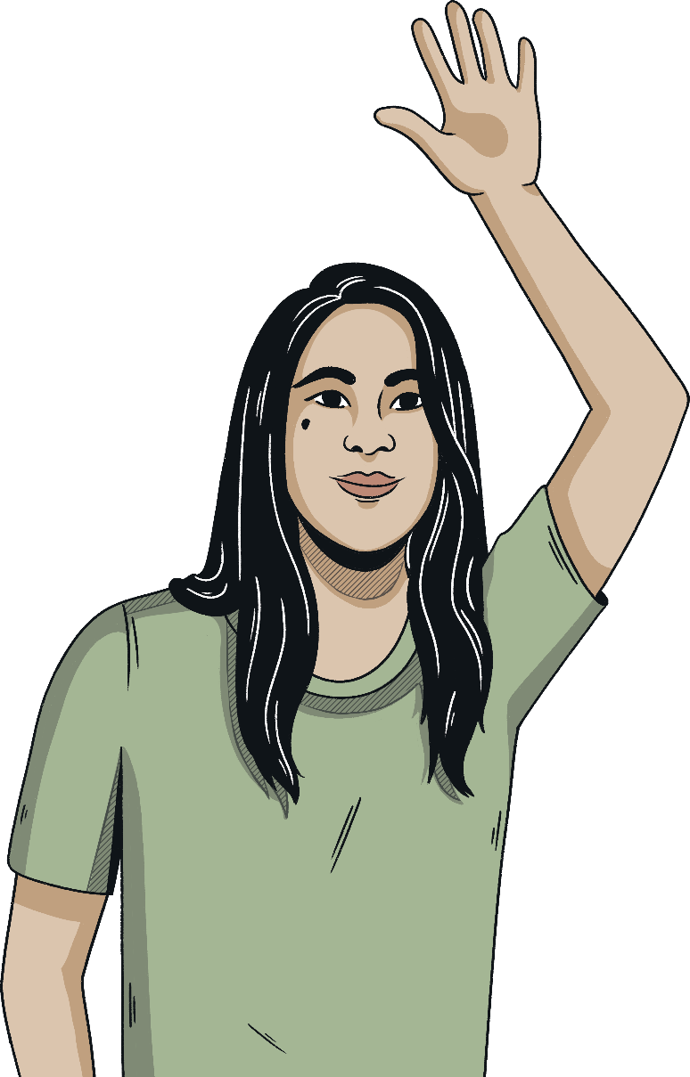
What is ADHD?
ADHD stands for Attention Deficit Hyperactivity Disorder.
ADHD is a type of neurodivergence that can affect the way people think, feel and act.
ADHD can vary for different people. Some people experience differences in their energy levels, impulse control and movement levels. ADHD can also affect concentration and attention in lessons, where learners require more time to regulate.

Slide 15
ADHD – How Can I Help?
Remember to be patient and understanding. You may need to repeat yourself or check they have understood what you have said.
Some people may find it difficult to understand rules in games or situations and might need additional support to understand this.
Some learners might seek out activities to meet their sensory needs, such as running around outside or using a fidget object.

Slide 16
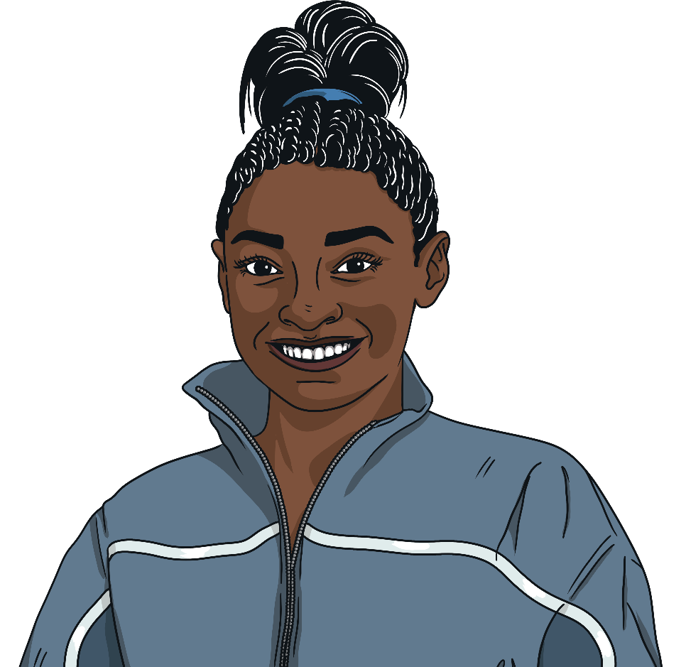
Famous People with ADHD
Simone Biles
Simone Biles rose to fame as a gymnast in 2013, when she won two World Championship gold medals at the age of 16. She has since gone on to win seven Olympic medals and is tied as the most decorated gymnast of all time.
ADHD can be seen as both an advantage and a disadvantage when it comes to sports, as it may allow an athlete to thrive under pressure and channel their energy.
However, a person with ADHD may also struggle to focus on sports. Biles has been praised for helping to address the stigma surrounding ADHD and other neurological conditions.
Biles said 'Having ADHD, and taking medicine for it is nothing to be ashamed of nothing that I’m afraid to let people know.'

